Slide 1

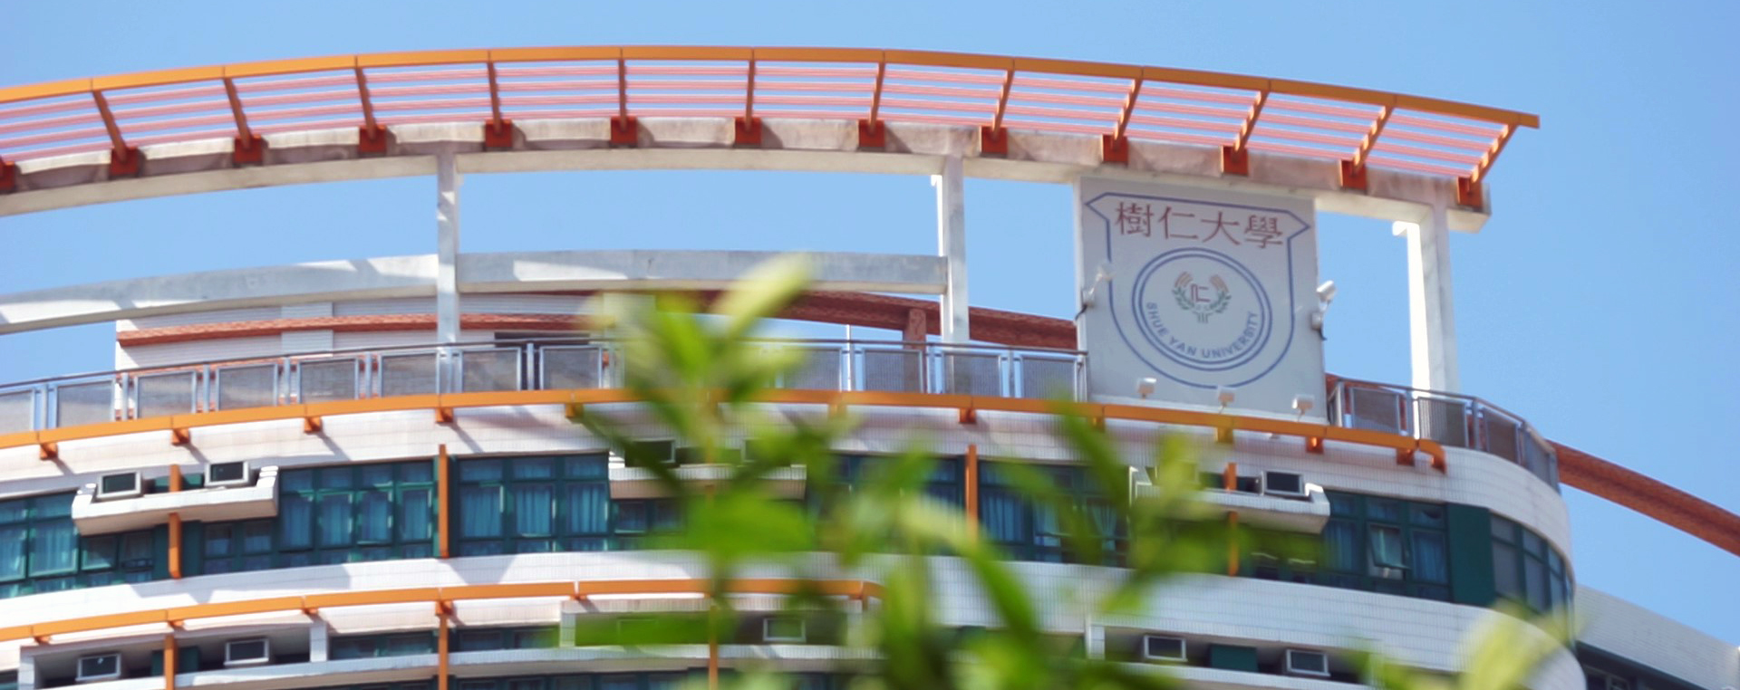
Department of Sociology, HKSYU
Introduction to BSocSc in Sociology programme
September 2025

Slide 2

Objectives of the Department:
Cultivate students' ability to analyze social phenomena.
Understand the social systems and cultures of Hong Kong, China, and around the world, establishing a global perspective.
Equip students with research techniques and the ability to argue in a rational way.
Enhance students' workplace competitiveness through specialized sociological research, digital learning and internship arrangements.

Slide 3
Teaching strategies of our Dept: A-R-P Approach
Academic Training
學術訓練
Practical Experience
實習經驗
Research Skills
研究技術

Slide 4
Courses（125 credits upon graduation in four years）
First year: 35 credits
Compulsory courses: 26 credits
    Language: Chinese and English (14 credits)
    Sociology core (12 credits):
      SOC100 Introduction to Sociology
      SOC103 Introduction to Anthropology
      SOC208 Hong Kong Society and Culture
      SOC108 Introduction to Statistics
Departmental Elective: 3 credits
General Education: 6 credits

Slide 5
Second year: 36 credits
Compulsory courses: 18 credits
    English: 6 credits
    Sociology core: 12 credits
      SOC205 and SOC207 Sociological Theory I & II
      SOC221 Social Research Methods
      SOC221A Applied Quantitative Social Research Methods
      or
      SOC221B Applied Qualitative Social Research Methods
Departmental Electives: 6 credits
      E.g. Cultures in the Contemporary World, Social Stratification, Food and Society, Social Problems, Art and Society etc.
General Education: 6 credits
Free Electives: 6 credits

Slide 6
Third year: 30 credits
Compulsory courses: 6 credits
    SOC345 Introduction to Digital Sociology
    SOC308 Culture, Heritage and Society
Concentration Departmental Elective: 6 credits
Non-concentration Departmental Elective: 12 credits
    E.g. Sociology of Education, Sociology of Deviance, Gender Relations, Criminology, Sociology of Religion, Love, Family and Kinship, Social Change and Modernity etc.
Free Electives: 6 credits

Slide 7
Concentrations（專題研習）
There are two concentrations in Year 3 and 4.
If you are Year 1 in 2025-26, choose either one of the followings:
Digital Sociology (DS) or
Culture, Heritage and Innovation (CHI)
If you are Year 2 and 3 in 2025-26, choose either one of the followings:
Entrepreneurship and Community (E&C) or
Culture, Heritage and Innovation (CHI)
➔ Total 15 credits for each concentration upon graduation, i.e. 3 credits core, 6 credits concentration electives in Year 3 and 4 respectively

Slide 8
Courses for concentrations (Year 1 in 2025-26)
Digital Sociology (DS)
Course code | Course title
(1) SOC345 | Introduction to Digital Sociology
(2) SOC262 | Digital Documentation and Research Methods
(3) SOC346 | Science, Digital Technology and Society
(4) SOC347 | Digital Economy and Society
(5) SOC348 | Digital Divide and Social Inequality
(6) SOC431 | Digital Governance and Smart Cities
(7) SOC432 | Body and Self in the Digital World
(8) SOC434 | Mining Data for Social Research
Culture, Heritage and Innovation (CHI)
Course code | Course title
(1) SOC308 | Culture, Heritage and Society (Compulsory)
(2) SOC311 | Sustainable and Innovative Cities in the Contemporary World
(3) SOC312 | Popular Culture in Asia
(4) SOC362 | Tourism and Culture
(5) SOC371 | Chinese Culture and Society
(6) SOC409 | Collective Memory and Social Change
(7) SOC413 | Digitized Media, Culture and Society
(8) SOC414 | Heritage Studies: Critical and Innovative Dimensions
(9) SOC415 | Film, Television and Society

Slide 9
Courses for concentrations (Year 2 and 3 in 2025-26)
Entrepreneurship and Community (E&C)
Course code | Course title
(1) SOC307 | Entrepreneurship and Society (Compulsory)
(2) SOC309 | Community Economy
(3) SOC310 | Social Enterprise in Asia
(4) SOC358 | Poverty, Social Policy and Social Innovation
(5) SOC411 | Impact of Social and Enterprise Innovation
(6) SOC412 | Contemporary Consumer and the Changing Community
(7) BUS480 | Business Ethics and Corporate Social Responsibility
(8) BUS483 | Digital Entrepreneurship
Culture, Heritage and Innovation (CHI)
Course code | Course title
(1) SOC308 | Culture, Heritage and Society (Compulsory)
(2) SOC311 | Sustainable and Innovative Cities in the Contemporary World
(3) SOC312 | Popular Culture in Asia
(4) SOC362 | Tourism and Culture
(5) SOC371 | Chinese Culture and Society
(6) SOC409 | Collective Memory and Social Change
(7) SOC413 | Digitized Media, Culture and Society
(8) SOC414 | Heritage Studies: Critical and Innovative Dimensions
(9) SOC415 | Film, Television and Society

Slide 10
Purposes of concentration
使課程有自選亦有專題探討環節，務求「廣」、「專」兼備
這兩個專題都是社會學熱門題材，且是社會發展中重要項目，若同學對這些範圍有認識，對就業很有幫助。
既有兩個選修實習課程 （Service Learning; Enterprise Learning） 可與專題範圍掛鈎，爭取相關機構實習經驗，有助畢業後在專題範圍內找工作。

Slide 11
Fourth year: 24 credits
Compulsory courses: 3/6 credits
    SOC400 Senior Seminar (3)
    SOC401-2 Honours Project (6)
Concentration Departmental Elective: 6 credits
Non-concentration Departmental Elective: 12/9 credits
    Sociology of Organization, Evaluation Research, Economic Reform and Social Transformation in Contemporary China, Selected Topics etc.
Free Electives: 3 credits

Slide 12

Internship
We provide credit-bearing courses in our BSocSc programme:
    SOC490 Work Placement
    SOC470 Service Learning
Aims:
  Experiential learning experience
  Proactive learning
  Be prepared for the job market

Slide 13






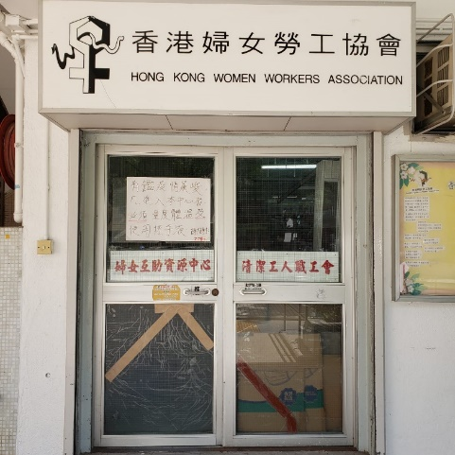

部份合作的社區組職/社企/企業

Slide 14

Highlights of our teaching and learning approaches
Our department adopts “Outcome-Based Teaching and Learning” approach in our teaching:
    E.g. Fieldtrip, uReply, Crio, many other online interactive devices
International Exchange programme
    E.g. Sweden, Canada, Taiwan, South Korea etc.

Slide 15
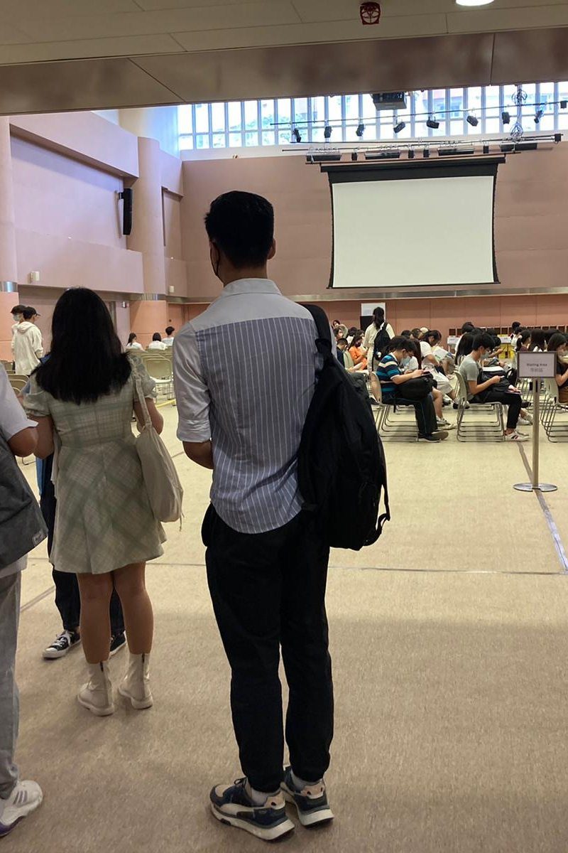
Student-teacher relations
Intensive communication between students and teachers
    Small class learning and daily interaction!
    Sociology Society
    Staff-tutor Scheme
    Student-staff Consultation Committee
Sociology alumni network, regular events with alumni, e.g. Christmas party and alumni sharing session

Slide 16
Department of Sociology
Hong Kong Shue Yan University
6 Wai Tsui Crescent, Braemar Hill, North Point, Hong Kong
Website: https://sociology.hksyu.edu/en
IG: @hksyu_sociology

